Slide 1
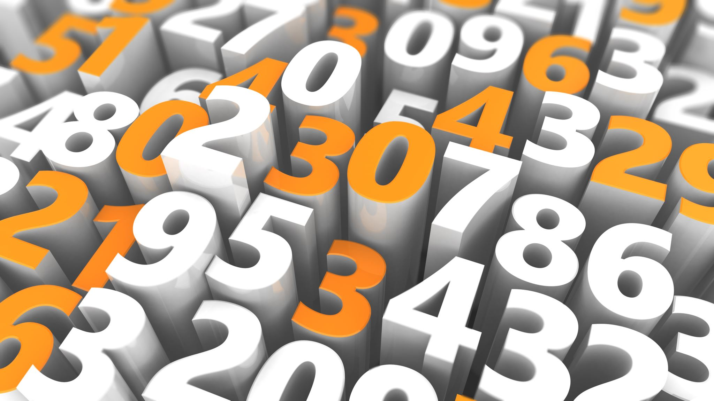
Project 1

Slide 2
Title: Data Cleaning and Exploration
Subtitle: A Guide by Vicky Saini

Slide 3
Brief Introduction to the Tasks
Definition: Combining two or more datasets into a single dataset
Purpose: Enhancing data completeness and analysis capabilities
Example: pd.merge function in Python

Slide 4
Definition: Combining two or more datasets into a single dataset
Purpose: Enhancing data completeness and analysis capabilities
Example: pd.merge function in Python

Slide 5
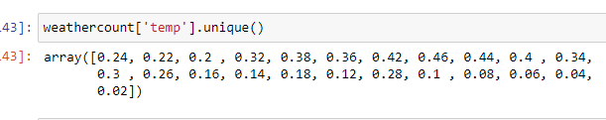
Identify Unique Values
Definition: Identifying distinct values in a column or dataset
Purpose: Understanding the diversity and uniqueness of data
Example: df .unique in Python

Slide 6
Drop Unnecessary Columns
Definition: Removing columns that do not contribute to analysis
Purpose: Reducing dataset dimensionality and improving performance
Example: df.drop , axis=1, inplace=True) in Python

Slide 7
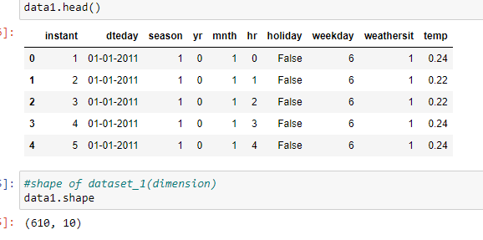
Check Dimensions of the Dataset
Definition: Examining the number of rows and columns in a dataset
Purpose: Understanding the size of the dataset
Example: df.shape in Python

Slide 8
Check Datatype of the Dataset
Definition: Identifying the data type of each column
Purpose: Ensuring proper data types for analysis
Example: df.dtypes in Python

Slide 9
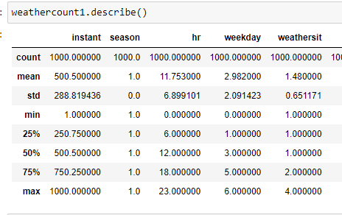
Check Data type Summary
Definition: Summarizing data types and counts
Purpose: Quick overview of the data types present
Example: df.describe() in Python

Slide 10
Treat Missing Values
Definition: Handling and filling missing values in the dataset
1
Purpose: Enhancing data quality and analysis accuracy
2

Slide 11
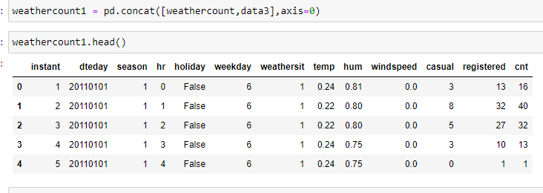
Concatenate Combined Data
Definition: Combining data along a particular axis
Purpose: Merging datasets vertically or horizontally
Example: pd.concat , axis=0) in Python

Slide 12
Check Skewness and Correlation
Definition: Analyzing data distribution skewness and variable correlations
Purpose: Understanding data distribution and relationships
Example: df.skew and df.corr in Python

Slide 13
Conclusion
Summary of the Data Cleaning and Exploration Process

